Slide 1


Data Warehouse with MongoDB
Migration Data from GS1 Canada IAM DB to MongoDB
2019.02
Muthu Ramakrishnan, Jongkuk Lee

Slide 2



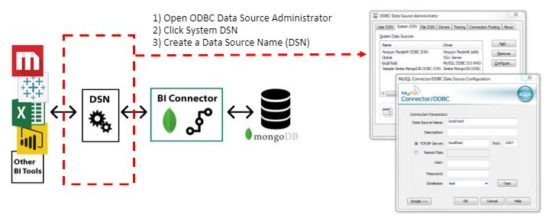

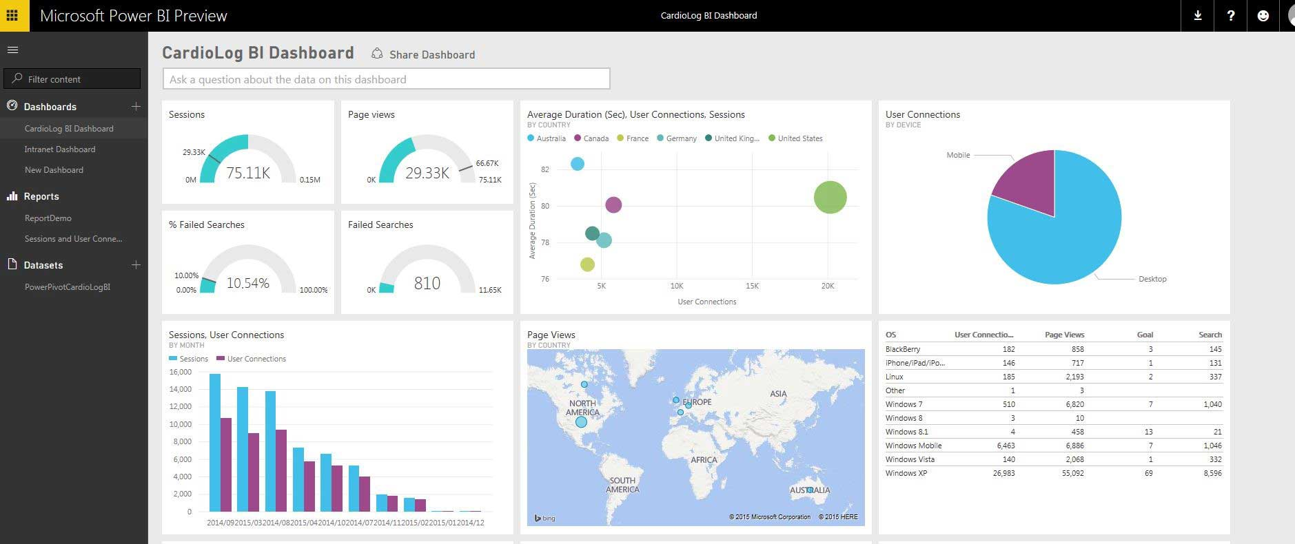

1. Scenario
IAM QA DB
in GS1 Canada
Migrate User Information from IAM DB to MongoDB
Apache NiFi
on Localhost Machine
Scenario:
1) User/Company/User_Role tables on GS1 Canada IAM DB
2) Migrate specific fields to one collection on MongoDB
3) View statistics page on Power BI cloud
Migration Strategy:
1) Design Schema Structure
2) Extract/ Transform/Load specific fields data from Users table on IAM
3) Extract/ Transform/Load specific fields data from Company table on IAM
4) Extract/ Transform/Load specific fields data from Users Role table on IAM
5) Combine Users and User Role Information to one embedding Collection
6) Create Statistics page on Power BI Desktop
7) Publish Statistics page on Power BI Cloud
8) Monitor statistics data in real-time
MongoDB
on Cloud
Power BI connector
- Publish analytic data on Power BI Cloud
- Monitor data in Real-Time

Slide 3
2. Procedure
Description
Guideline
Role
Start
• Change Schema Structure
from RDBMS to MongoDB
• How to collapse 2 RDBMS Tables
to 1 BSON Documents
Schema Design
• Create Schema Mapping Table
• Schema mapping chart.xml
Fix
Mapping
Design Statistics Page
• Review Schema Mapping Table
If pass then move to next step
else move back to previous step
• Manual Check
NO
Review
Implement Power BI Desktop
Fix Schema Mapping Chart
• Implement Migration App
using Apache NIFI tool
• Migration using Apache NIFI
OK
Implement
Publish to
Power BI Cloud
• Migrate data
from RDB to MongoDB
using Apache NIFI tool
• Migration using Apache NIFI
OK
Fix
Migrating
End
• Check Migrated Data Quality
If pass then move to next step
else move back to previous step
• Migration and Quality Check
Delete Data
NO
Quality
Fix Apache NIFI Template File

Slide 4

3. Design Schema Structure
IAM
MongoDB
User
UserId
Eamil
FirstName
LastName
User
UserId
Eamil
FirstName
LastName
User Roles
UserId
CompanyId
RoleId
RoleName
ServiceId
ServiceName
LastLogin
NumberOfLogin
Convert to
Embedding Structure
User Roles
UserId
CompanyId
RoleId
RoleName
ServiceId
ServiceName
LastLogin
NumberOfLogin
Company
CompanyId
Name
Type
Company
CompanyId
Name
Type
Convert to
Referencing Structure
Users and Users Roles are 1:Many, Parent-Child, Composition Relationship
→ Can be candidates for embedding Structure
User and Company are Many:Many, Association relationship
→ Can be candidates for Referencing Structure

Slide 5
4. Column Mapping
Seq | RDBMS |  |  | MongoDB
 | Database | Table | Column | Collection | Field | Sub Field | Type | Depth
1 | IAM | Users | UserId | users_ms | UserId |  | String | 1
2 | IAM | Users | Eamil | users_ms | Eamil |  | String | 1
3 | IAM | Users | FirstName | users_ms | FirstName |  | String | 1
4 | IAM | Users | LastName | users_ms | LastName |  | String | 1
5 |  |  |  | users_ms | UserRoleInfo |  | Array
6 | IAM | User Roles | RoleId | users_ms |  | RoleId | String | 2
7 | IAM | User Roles | CompanyId | users_ms |  | CompanyId | String | 2
8 | IAM | User Roles | RoleName | users_ms |  | RoleName | String | 2
9 | IAM | User Roles | ServiceId | users_ms |  | ServiceId | String | 2
10 | IAM | User Roles | ServiceName | users_ms |  | ServiceName | String | 2
11 | IAM | User Roles | LastLogin | users_ms |  | LastLogin | String | 2
12 | IAM | User Roles | NumberOfLogin | users_ms |  | NumberOfLogin | String | 2
13 | IAM | Company | CompanyId | compnaies_ms | CompanyId |  | String | 1
14 | IAM | Company | Name | companies_ms | Name |  | String | 1
15 | IAM | Company | Type | companies_ms | Type |  | String | 1

Slide 6
5. Activity Diagram
Start
3. Migrate Users Role Info
Extract Data
Extract Data
Extract Data
Transform Data
Transform Data
Transform Data
Backup Data
Backup Data
Backup Data
Success
Success
Load Data
Load Data
Load Data
1. Migrate Users Info
2. Migrate Company Info
Combine Data
4. Combine Users and User’s Role Info
This diagram will be used to implement Processor Group on Apache NiFi.
End

Slide 7
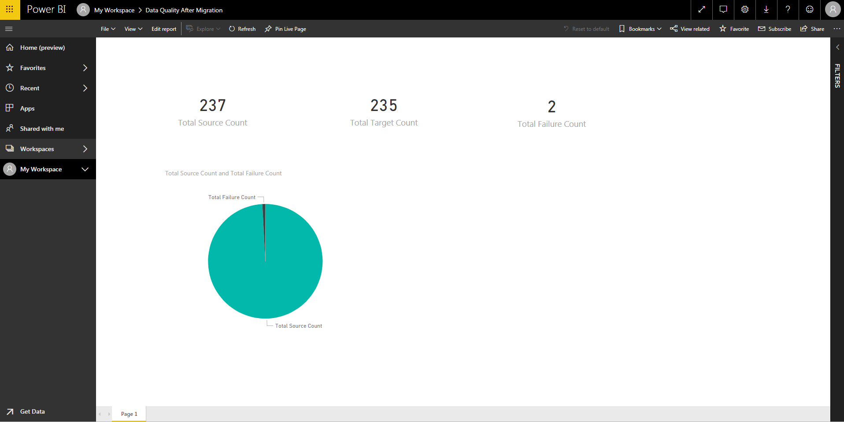
6. Statistics
Create Analytic Page using Power BI Desktop and Publish it to Power BI Cloud
[Layout]
This page will be used to implement/publish a Statistics page on Power BI.
[In/Output Definition]
Seq | IO | Display Name | Content | Table/collection | Field | Sub Field
1 | O | Total Source Count | This field displays the number of row of source tables on IAM. Calc: Count(UserId) + Count(RoleId) + Count(CompnayId) | Users | UserId
 |  |  |  | User Roles | RoleId
 |  |  |  | Company | CompanyId
2 | O | Total Target Count | This field displays the number of row of target collections on MongoDB. Calc: Count(UserId) + Count(RoleId) + Count(CompnayId) | users_ms | UserId
 |  |  |  | users_ms | UserRoleInfo | RoleId
 |  |  |  | compnaies_ms | CompanyId
3 | O | Total Failure Count | This field displays the number of failure row after migration. Calc: Total Source Count - Total Target Count

Slide 8
UserId | varchar(255)
Email | varchar(256)
ContactId | varchar(20)
FirstName | varchar(255)
LastName | varchar(255)
CompanyId | varchar(64)
CompanyName | longtext
IsPrimaryCompany | varchar(5)
GLN | varchar(50)
SubscriberId | bigint(20)
Ctype_en | varchar(8000)
Ctype_fr | varchar(8000)
ServiceGroupId | int(11)
ServiceGroupName | varchar(255)
ServiceRoleNameEn | text
ServiceRoleNameFr | text
ServiceId | varchar(64)
role_Companyid | varchar(64)
role_UserId | varchar(64)
CreatedDate | datetime
LastModifiedDate | datetime
l_LastLoginDate | datetime
l_TotalLogins | bigint(21)
NameEn | text
NameFr | text
LastTCAcceptedDate | datetime
LastTCVersionAccepted | varchar(20)
10.10.30.46
dw_user
DataW1
/****** Script for SelectTopNRows command from SSMS ******/
SELECT top 10 storage.[Id]
,ims_description
,[itemid]
,[instancenumber]
,[content]
,[dateupdated]
FROM [EEV3_ContentDistribution].[dbo].[Storage] inner join ims on Storage.imsid=ims.Id

